Slide 1


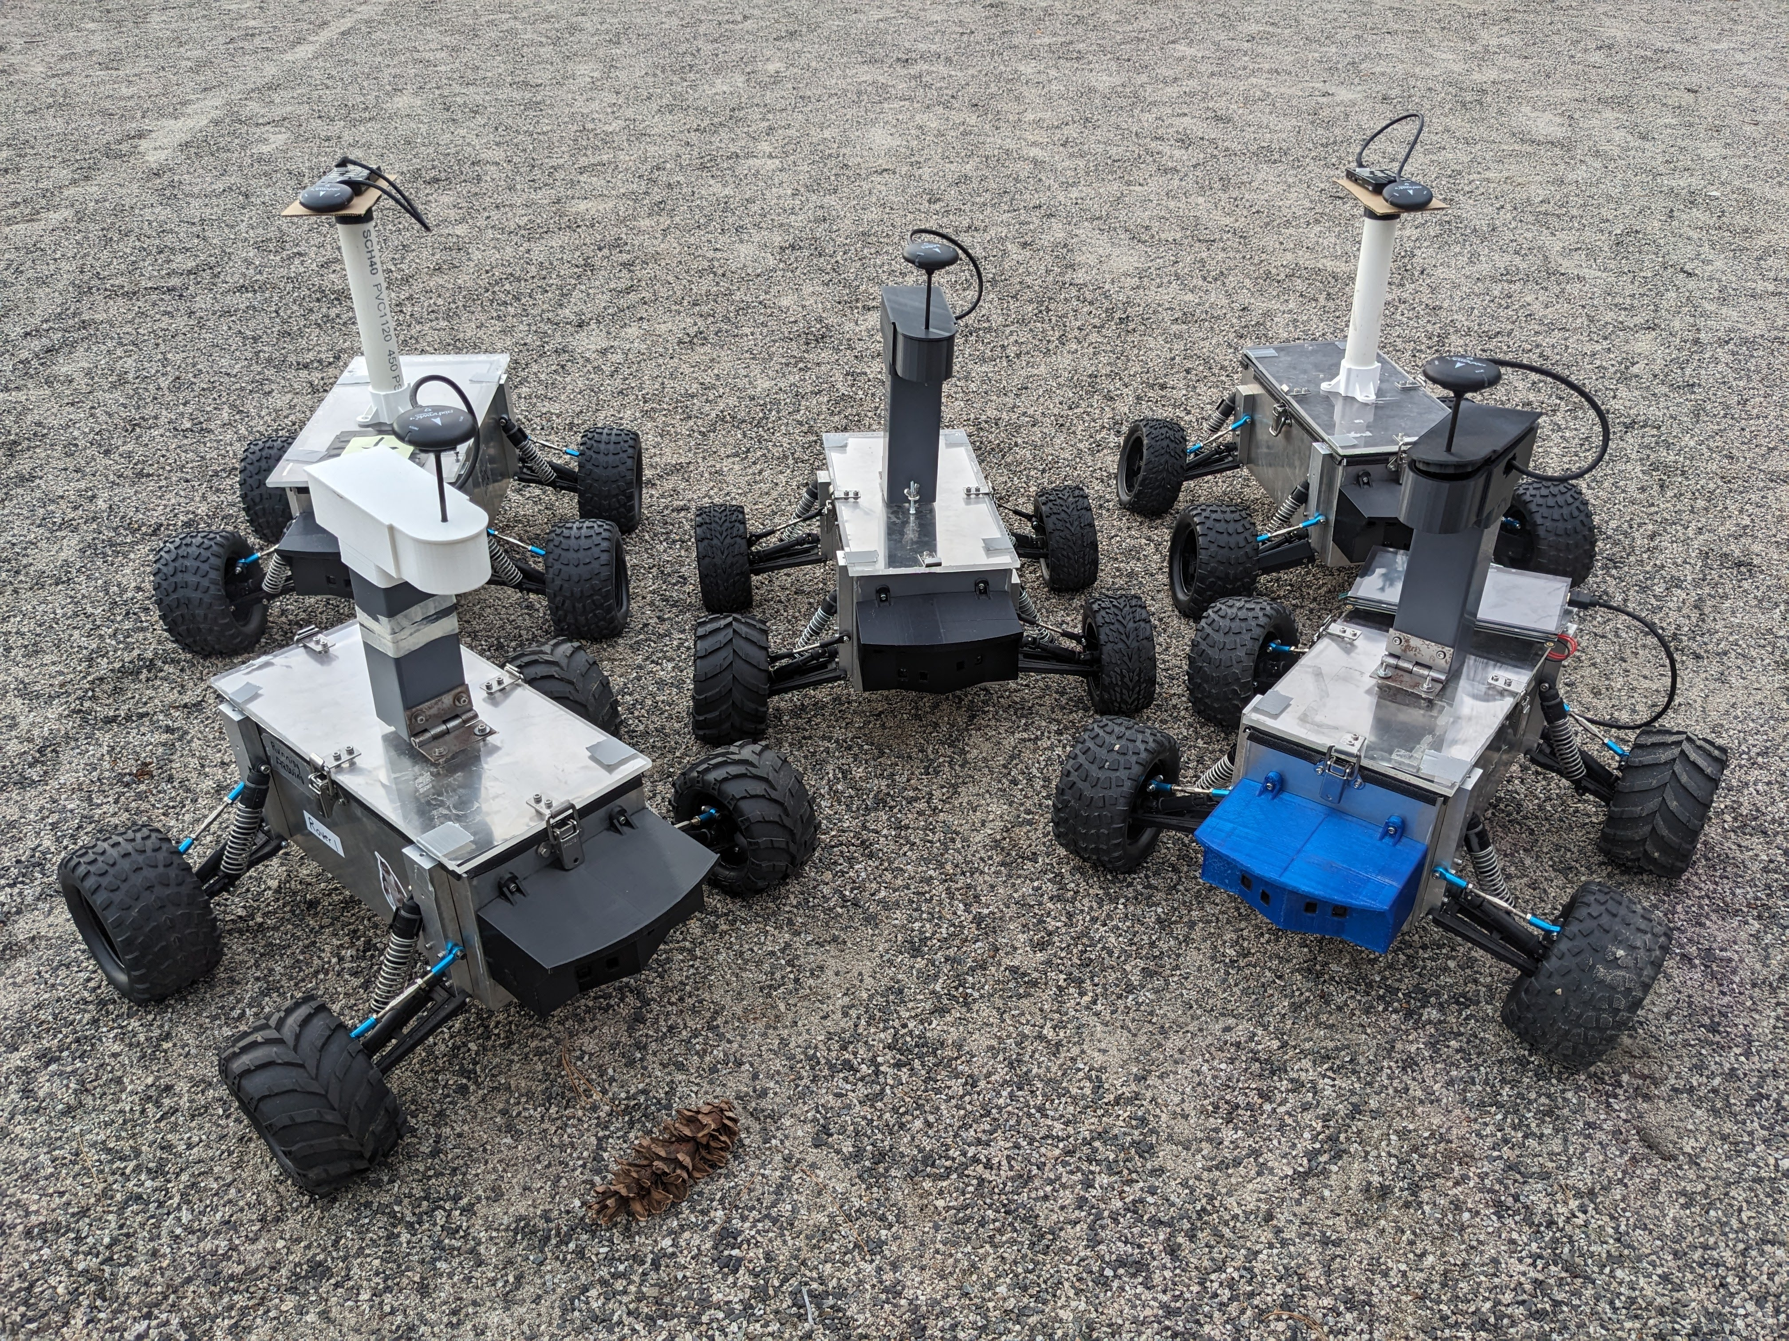
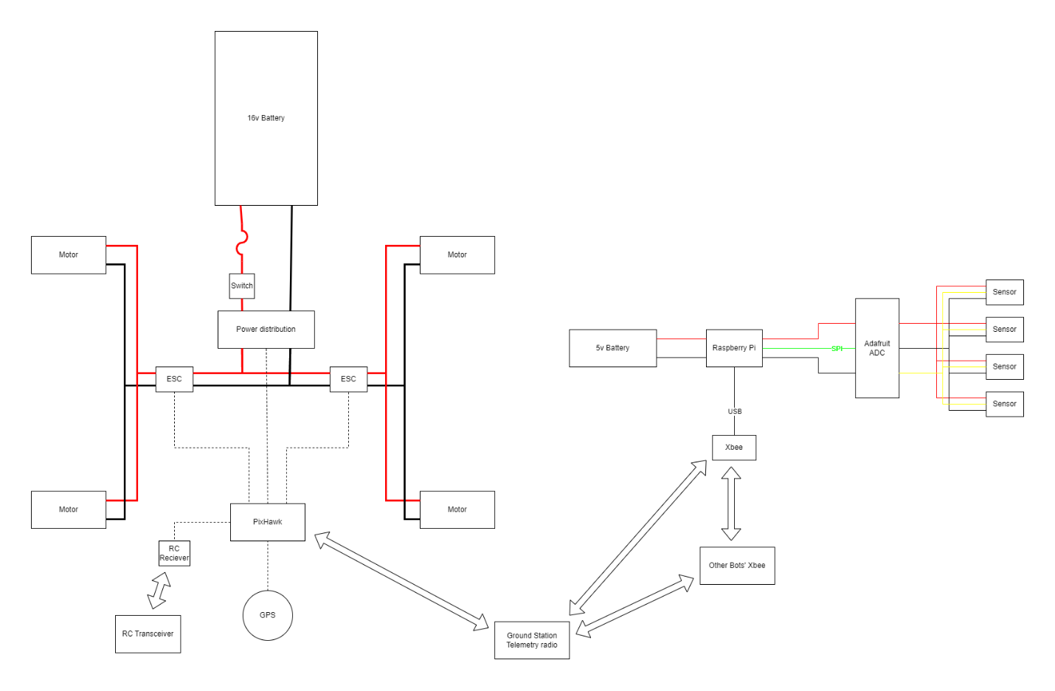
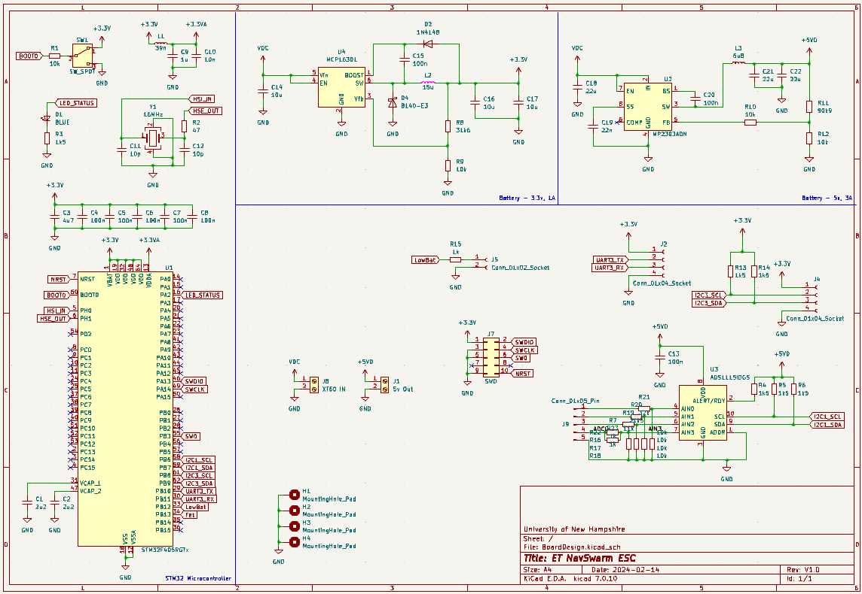
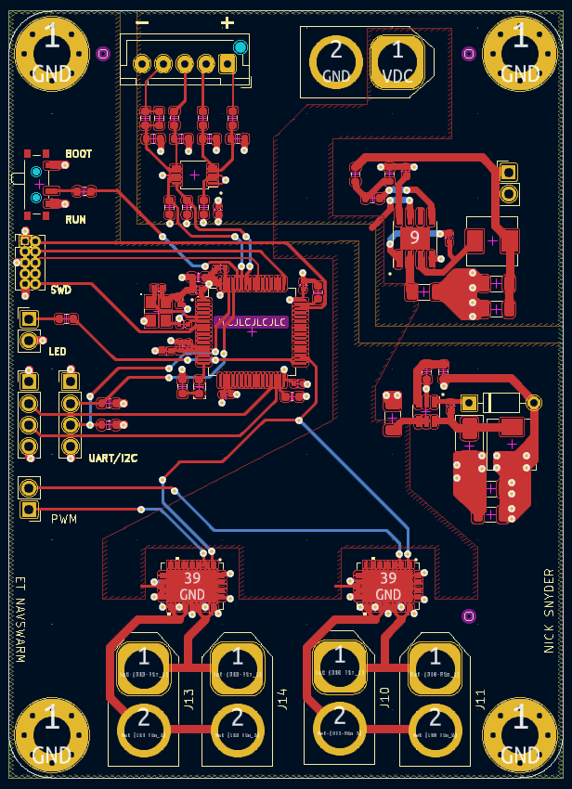
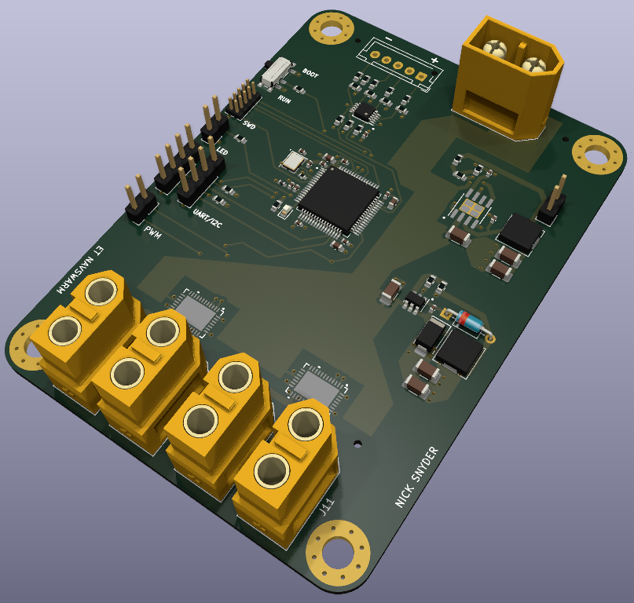
ET NavSwarm – PCB Design Nick Snyder, Nate Cannon, Anuj Joshi, Cooper Montgomery, Sam Muldrow Department of Electrical and Computer Engineering, University of New Hampshire, Durham, NH 03824
Introduction
Rovers
Results
ET NavSwarm is an interdisciplinary group with the end goal of sending a swarm of small autonomous rovers to another planet to prospect for materials. The group is now implementing the particle swarm algorithm to all the rovers to communicate with each other. Some areas for improvements the group have identified are active battery monitoring and hardware longevity.
Delays were faced in the development of this board. From finding out of stock chips to simple spelling errors for part numbers while trying to send the fabrication and assembly order. The MOSFET driver ICs and the 5V buck regulator IC are among these chip shortages from the fabricator. This has resulted in looking toward other part marketplaces for the necessary components.
Swarm of Five Rovers
Wiring Diagram and High-Level Schematic of the Rovers
Methodology
Designs
Conclusions
My focus was on motor control and how to increase the reliability of the rovers. I chose to design an all-in-one printed circuit board to control the motors and watch battery health. I created my designs in Kicad and fabricated the boards with the help of JLCPCB out of China. My goals were to design an easy to program motor controller with enhanced battery monitoring to alert the users of failing or degrading batteries.
Designing a PCB is a valuable skill for engineers rarely taught in the classroom. YouTube videos, application notes, and datasheets were combed through for optimal layouts for buck regulators or ensure steady DC for the MCU. Looking at components on quality speed controllers helped narrow the search. A version 2.0 would include higher current capabilities for the MOSFET drivers and the 5V output.
Features:
I²C
UART
SWD
XT60 power input
16 MHz external clock
Schematic
Data
Printed Circuit Boards
Acknowledgements
This design is centered around the STM32F4 MCU. This is a very capable chip with variations found in high power speed controllers for electric bikes. A buck regulator circuit powers the MCU while it sends and receives data on an I²C network for reading the cell voltages of the battery and displays it to an LCD along with interfacing with the MOSFET driver ICs. Another buck regulator circuit supplies power to an external Raspberry Pi and Arduino for autonomous capabilities.
Jim Abare, TSC Staff
Qaioyan Yu, Ph.D., Advisor
May-Win Thein, Ph.D., Advisor
Electric Vehicle Organization, Student Organization
Features:
4 layers
2 internal PWR/GND planes
HASL (lead)
FR4
Dimensions: 65mm*90mm
References
Phil’s Lab, YouTube Channel
Texas Instruments, Datasheets
ST Microelectrics, Application Notes
PCB Layout
Ray-traced render of PCB

